Slide 1
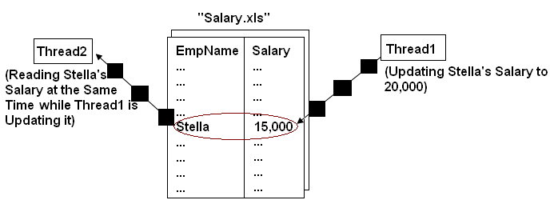


Implementing Thread Synchronization
  In a multithreaded environment, when two threads need to share data, you must try to coordinate their activities.
  The following figure shows two threads accessing the data of a file at the same time.

Slide 2
Synchronizing Threads
  The synchronization of threads ensures that if two or more threads need to access a shared resource, then that resource is used by only one thread at a time.
  You can implement thread synchronization by using the following approaches:
    By using the synchronized methods
    By using the synchronized statement
  You can synchronize a method by using the synchronized keyword.
  All the Java objects have a monitor and only one thread can hold the monitor of an object at a given time.
  The monitor controls the way in which synchronized methods access an object or class.

Slide 3
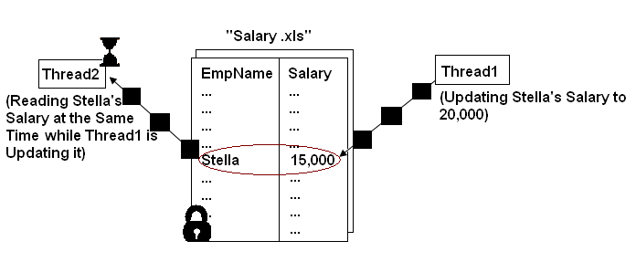
Synchronizing Threads (Contd.)
  When a thread acquires a lock, it is said to have entered the monitor.
  The monitor ensures that only one thread has access to the resources at any given time.
  When a thread is within a synchronized method, all the other threads that try to call the method at the same time have to wait.
  The following figure shows an example of thread synchronization.

Slide 4
Synchronizing Threads (Contd.)
  The following code snippet demonstrates how to implement synchronization by using a synchronized method:
      class EmployeeDetails
      {
      // Details of the employee
      }
      class EmployeeSalaryTransaction
      {
      public synchronized void processSalary()
      {
      // Code to process the salary
      }
      }

Slide 5
Synchronizing Threads (Contd.)
  Synchronization among threads can also be achieved by using synchronized statements.
  The synchronized statement is used where the synchronization methods are not used in a class and you do not have access to the source code.
  You can synchronize the access to an object of this class by placing the calls to the methods defined by it inside a synchronized block.
  The following code snippet shows how to use the synchronized block:
  synchronized(obj)
  {
  /* statements to be synchronized*/
  }

Slide 6
Implementing Inter-threaded Communication
  Threads can communicate with each other.
  Multithreading eliminates the concept of polling by a mechanism known as interprocess communication.
  The various methods used in inter-threaded communication are:
wait():
Informs the current thread to leave its control over the monitor and wait until another thread calls the notify() method.
notify():
Wakes up a single thread that is waiting for the monitor of the object being executed. If multiple threads are waiting, one of them is chosen randomly.
notifyAll():
Wakes up all the threads that are waiting for the monitor of the object.

Slide 7
Implementing Inter-threaded Communication (Contd.)
  Consider the code given in the embedded document that shows the
  producer-consumer problem, but without inter-threaded communication:
  To avoid the errors in the preceding code, wait(), notify(), and notifyAll() methods are used.
  Consider the code given in the embedded document that shows the inter-thread communication by using the wait() and notify() methods:

Slide 8
Just a minute
  The ______ method is used to wake up all the threads that are waiting for the monitor of the object.

Slide 9
Just a minute (Contd.)
  Solution:
    notifyAll()

